Slide 1
CS302 Operating System Lab 5 Concurrency: Mutual Exclusion and Synchronization 2
April 4th , 2018
Dongping Zhang
cadongllas@gmail.com

Slide 2
Semaphores
Semaphore is a variable that has an integer value
Initialize: a nonnegative integer value
semWait (P): decreases the semaphore value. the value becomes negative, then the process executing the semWait is blocked.
semSignal (V): increases semaphore value. If the resulting value is less than or equal to zero, then a process is blocked by a semWait operation, if any, is unblocked.

Slide 3
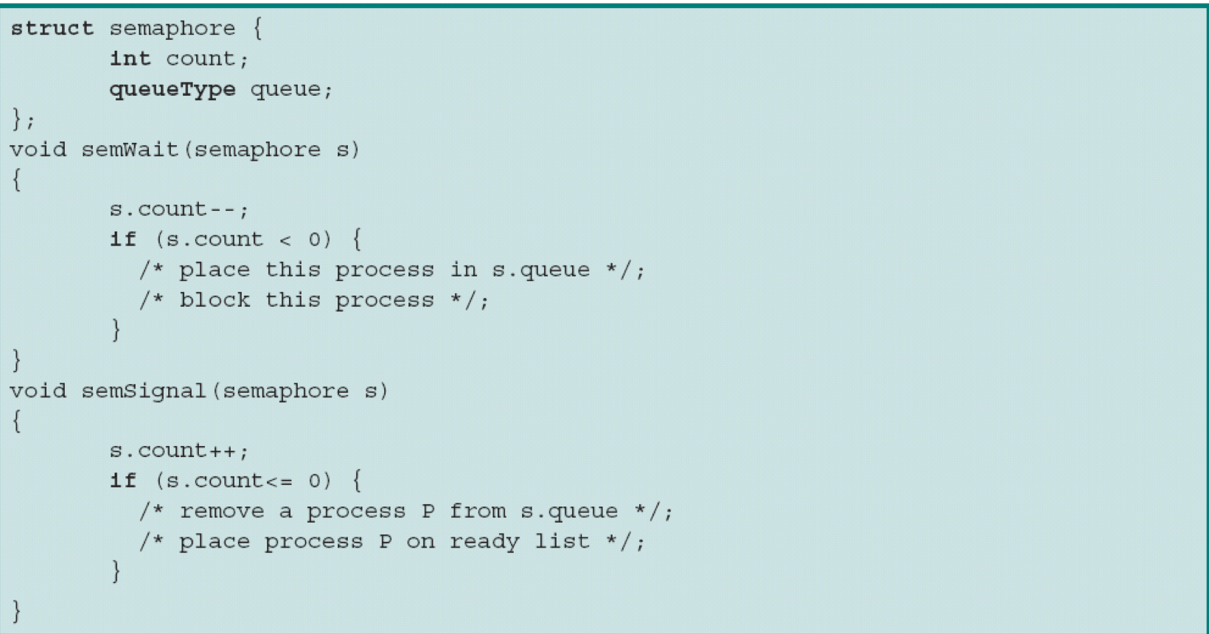
Semaphores

Slide 4
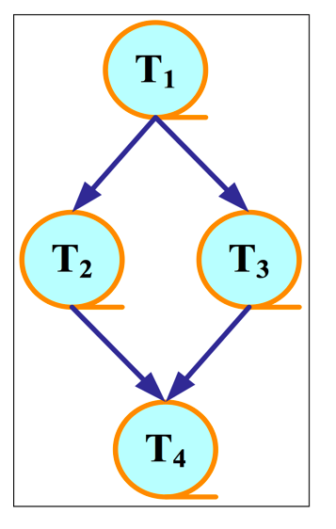
Semaphores

Slide 5
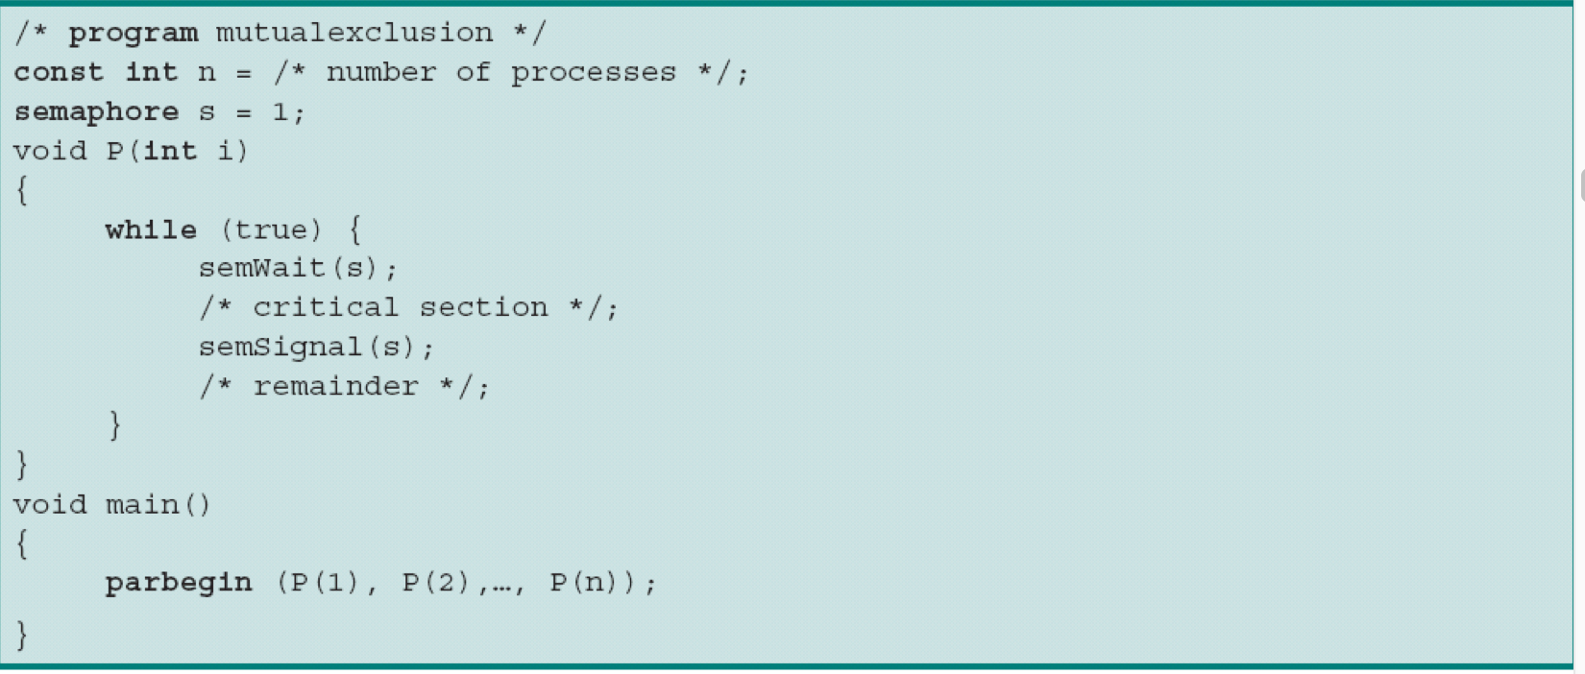
Mutual Exclusion using Semaphores
a

Slide 6
Semaphore in C
semaphore.c shows how to use these functions to create, operate and remove named semaphore.
compile semaphore.c like this: gcc semaphore.c -pthreaad -o semaphor
Function | Description
sem_open | Opens/creates a named semaphore for use by a process
sem_wait | lock a semaphore
sem_post | unlock a semaphore
sem_close | Deallocates the specified named semaphore
sem_unlink | Removes a specified named semaphore

Slide 7
Producer/Consumer Problem (生产者消费者问题)
One or more producers are generating data and placing these in a buffer
A single consumer is taking items out of the buffer one at time
Only one producer or consumer may access the buffer at any one time

Slide 8
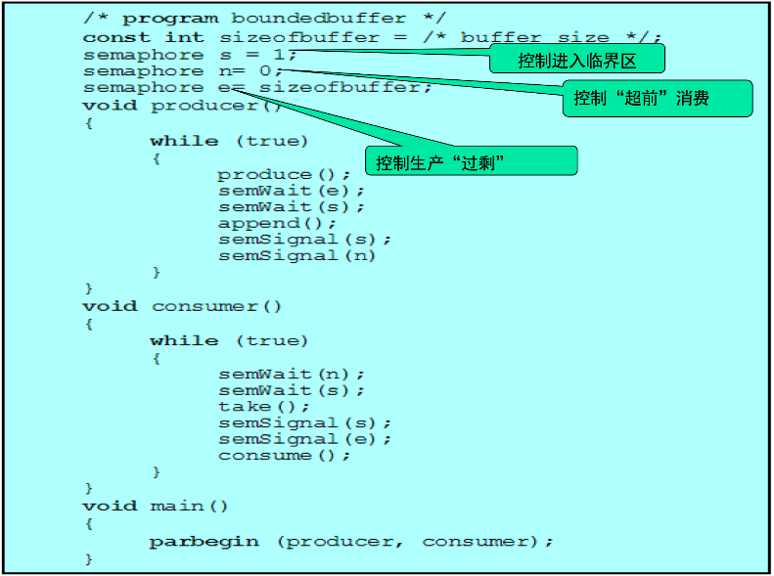
Producer/Consumer Problem

Slide 9
Readers/Writers Problem
There is a data area shared among a number of processes. The data area could be a file, a block of main memory, or even a bank of processor registers. There area number of processes that only read the data area(readers) and a number that only write to the data area(writers). The conditions that must be satisfied are as follows:
Any number of readers may simultaneously read the file
Only one writer at a time may write to the file
If a writer is writing to the file, no reader may read it

Slide 10
读者-写者问题
有两组并发进程
读者和写者,共享一组数据区
要求
允许多个读者同时执行读操作
不允许读者、写者同时操作
不允许多个写者同时操作

Slide 11
读者-写者问题
互斥关系
读者和写者不能同时进入共享数据区
多个写者不能同时进入共享数据区
多个读者可以同时进入共享数据区
同步关系
读者进入缓冲区，写者必须等待
写者进入缓冲区，读者必须等待

Slide 12
信号量描述
读者来
无读者、写者，新读者可以读
有写者等，但有其它读者正在读，则新读者也可以读
有写者写，新读者等
写者来
无读者，新写者可以写
有读者，新写者等待
有其它写者，新写者等待

Slide 13
读者-写者问题
两个进程
Reader、Writer
读者与写者间的互斥信号量：Wmutex＝1
多个读者间的互斥信号量：Rmutex＝1
Readcount：正在读取的进程数目
Readcount＝0时允许写

Slide 14
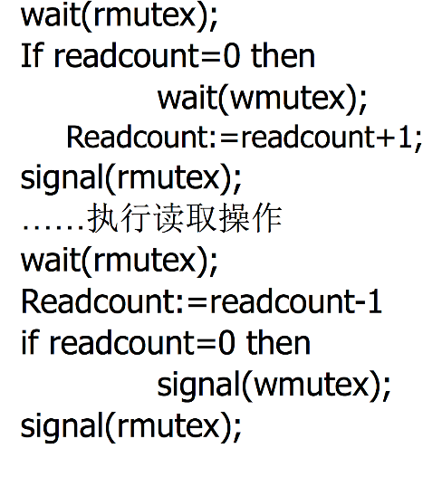
读者部分

Slide 15
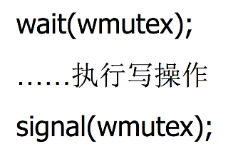
写者部分

Slide 16
Report for Lab 5
Please complete the report
Please complete ”read.c” and “write.c”, and your output should be same to “output_sample.txt”
Name your document as OS_Lab5_XXX_YYYYYYYY.zip, contains :
OS_Lab5_XXX_YYYYYYYY.doc
read.c
write.c
Replace XXX with your name and replace YYYYYYYY with your student id
Suche as OS_Lab5_张三_12345678.zip
Check the blackboard for deadline

